Slide 1


Game Title: COVID RUSH (疾走! COVID-19!)
Team: 01
Name / Student ID: 吳岱容 / 310551067
Name / Student ID: 李諭樹 / 310552024
Name / Student ID: 呂思函 / 0716207
Course Project for 3D Game Programming
Instructor: Sai-Keung Wong
NCTU,
2022/01/10
Notes:
Good morning everyone
we would like to share our final report
Our game title is covid rush
my name is 呂思函 and team members are 岱容 and 諭樹

Slide 2
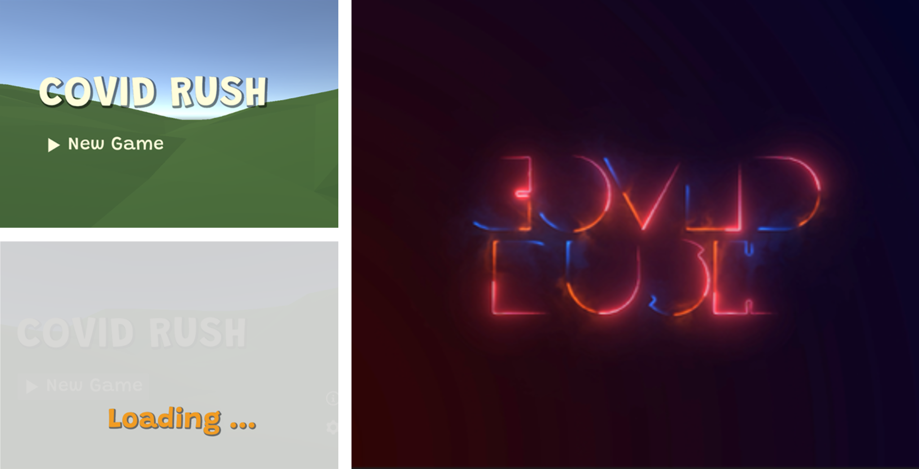
Representative images
Notes:
here are several representative images

Slide 3
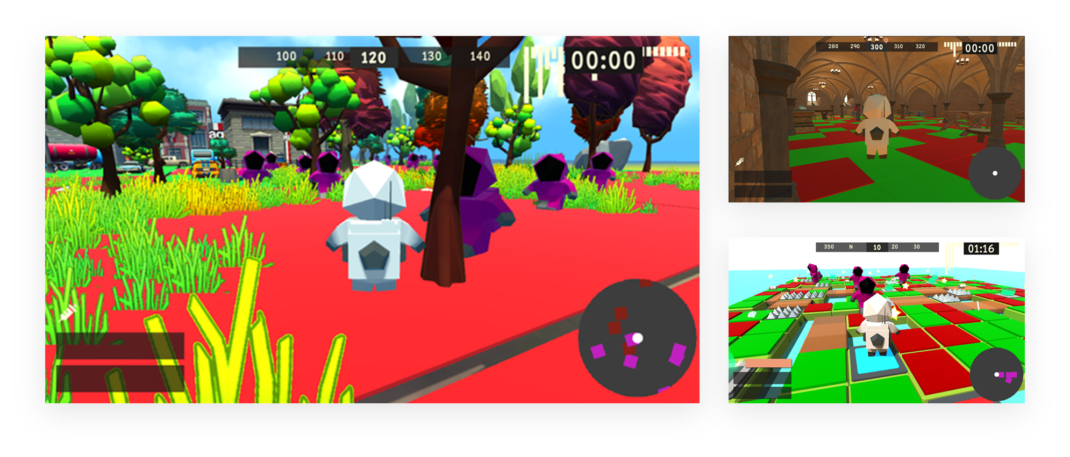
Representative images

Slide 4
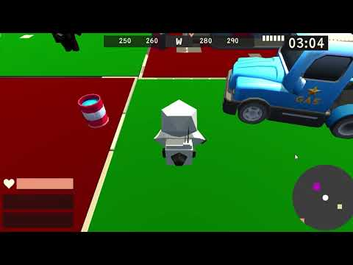

Slide 5
Content
Game Design
System Architecture
Techniques
Contributions & Implementation items
Milestones & Schedule
Demo
Conclusion
Acknowledgement & Reference Lists
Notes:
This is our outline

Slide 6
Game Design
Game Features
Game Story
Game Goal
Game Control
Game Levels
Characters & Props
Particle systems
Sound effects
Game Intro

Slide 7
Game Design - Game features
Immerse Experience
New Game Mode
Fascinating Scenes
Notes:
The story fits current reality. Plots, music, and game mode will give players nervous feelings and excitement. They can easily immerse themselves in the game world, and have similar but more exciting experiences different from reality.
Players can not only interact with NPCs but also collect supplies in game. There are several significant characteristics in our game, such as music switches terrains combined with Tag’s (鬼抓人) elements, and getting to the safe regions to avoid infected, etc.
Because changing terrains and safe regions is the main element in COVID RUSH. There will be several fascinating scenes switching during the game.

Slide 8
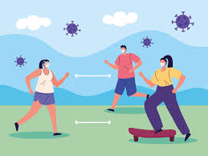
Game Design - Game story
Severe disease has stroken the world for a period of time. The governments of countries try hard to have citizens vaccinated. They also strongly appeal to their citizens to wear masks in order to protect themselves and others.
You have gradually noticed the situation of spreading disease, and you also find out that some regions are severe and some are not. People tend to get rid of dangerous regions and swarm into safe regions. While they enter the safe region, they still try to grab more supplies they can.
Watching those raving behavior, you are conscious of making yourself out of threat right now!
Notes:
Severe disease has stroken the world for a period of time. The governments of countries try hard to have citizens vaccinated. They also strongly appeal to their citizens to wear masks in order to protect themselves and others.
Players must try to get rid of dangerous regions and run into safe regions. Also, try to grab more supplies as you can.

Slide 9
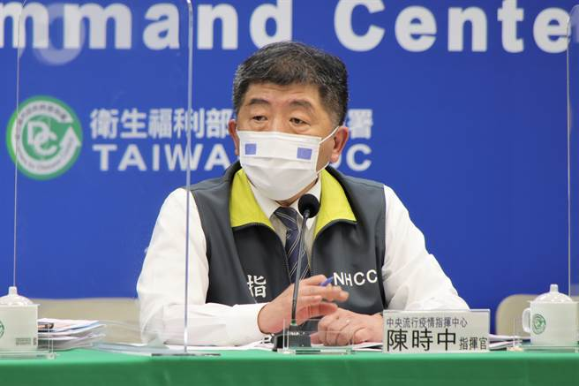
Game Design - Game goal
if you step on the dangerous zone (red bricks), your life value will decrease
get vaccine to recover your life value!
if you encounter NPCs, try to get rid of them!
they are going to chase you and grab your facemasks and needles!
So try your best to collect the props during the game as much as possible
observe the music tempo and make yourself on safe zone (green bricks)!
Don’t forget to put on your mask!
Protect yourself and people around ˋ( ° ▽、° )

Slide 10
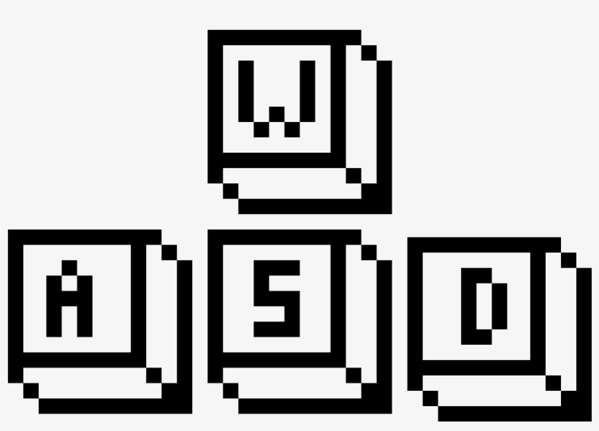
Game Design - Game control
Keyboard Control
Key W to let the character move forward
Key S to let the character move backward
Key A and D to control the character rotation
Attach camera to player
Mouse move to control the player’s perspective
Mouse roll to control the player camera distance

Slide 11
Game Design – Game Levels
There are three levels in our game :
City
Grass
Crypt

Slide 12
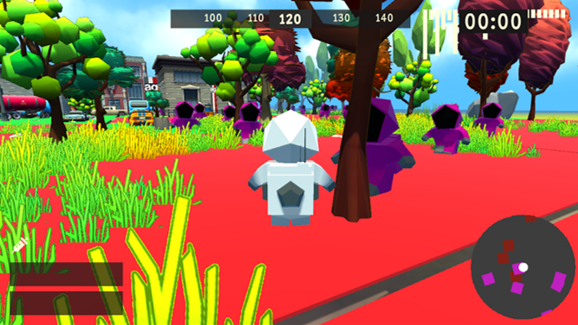
Game Design – Game Levels
City
city elements : pavements, cars, buildings, and plants, etc.
find different Unity Assets and build the city view

Slide 13
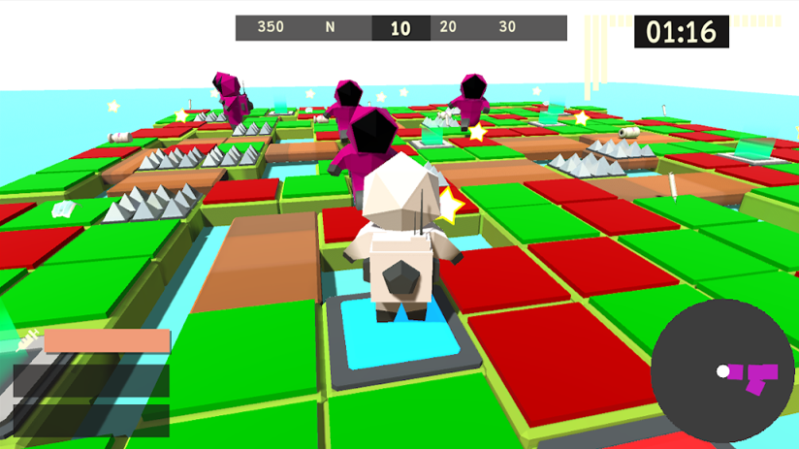
Game Design – Game Levels
Grass
add water and trap to increase difficulty of the level
the main terrain is built with simple cubes

Slide 14
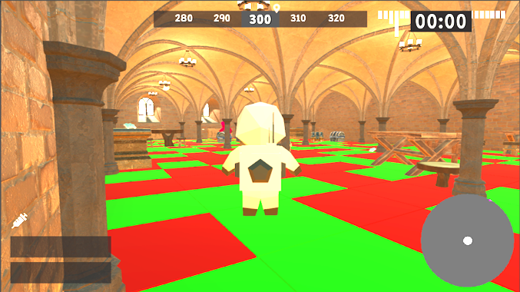
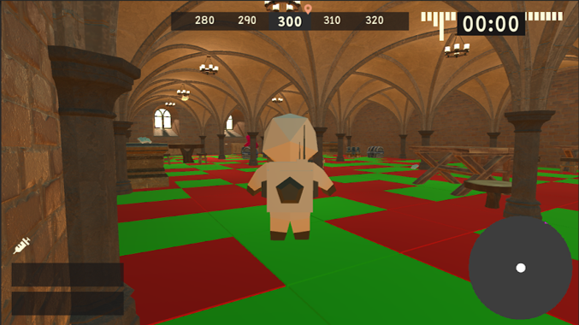
Game Design – Game Levels
Crypt
smallest scene with several sundries
more difficult to dodge from the NPCs

Slide 15
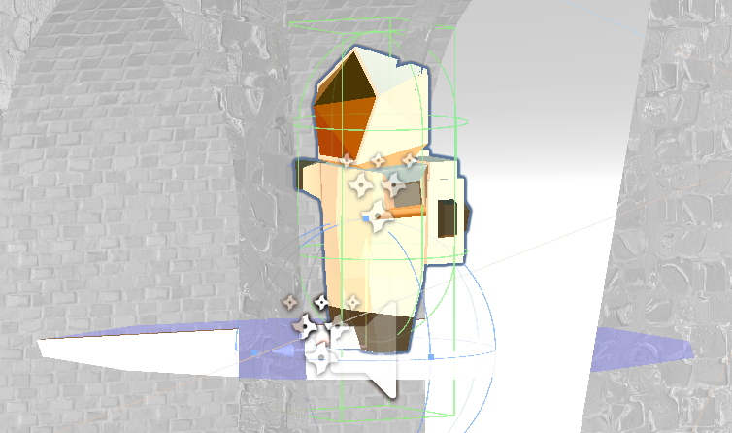
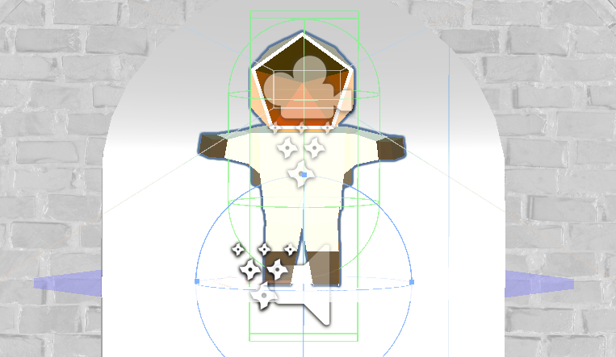
Game Design – Characters & Props
Player
protective clothing
facemask
backpack for medical usage

Slide 16
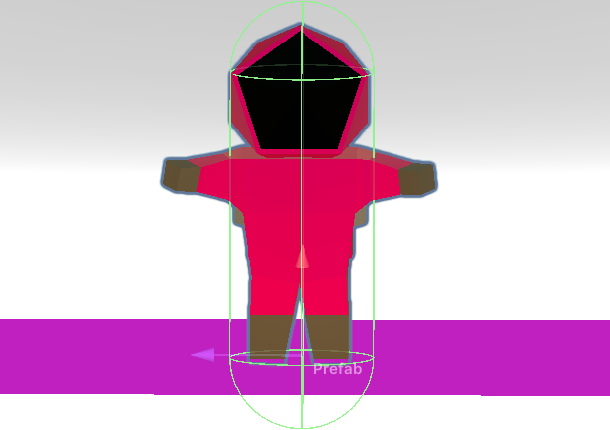
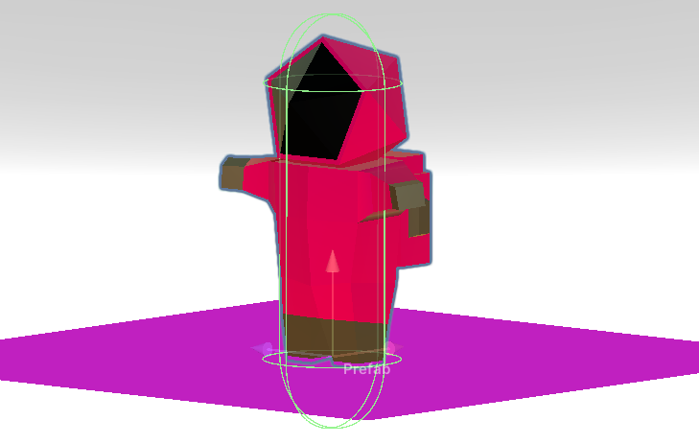
Game Design – Characters & Props
NPC
human figure but use different colors to highlight the difference with the player
selected color is referred to Squid Game

Slide 17
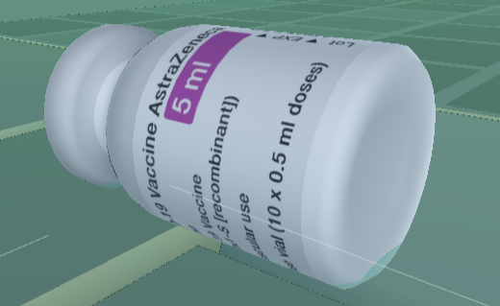
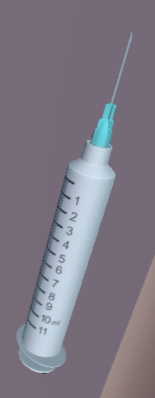
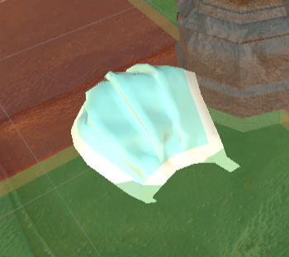
Game Design – Characters & Props
Props
needle
facemask
vaccine
Notes:
player has to collect all the needles and facemasks in the specific scene so that he can pass the level
if he needs more time to collect props, he can collect vaccine to get more time to complete
vaccine is like the value of life or blood

Slide 18
Game Design – Particle systems
Picking Props
Collision with NPCs
Terrain decoration
Complete levels
Notes:
there are three particle effect in game

Slide 19
Game Design – Particle systems
Picking Props

Slide 20
Game Design – Particle systems
Collision with NPCs
Notes:
burst particles like blood and virus
so the color was chosen as red and black

Slide 21
Game Design – Particle systems
Terrain decoration
Notes:
learning different kinds of particle system
practice them in our project

Slide 22
Game Design – Particle systems
Complete Levels
Notes:
there are three particle effect in game

Slide 23
Game Design – Sound effects
pick props
opening music
background music in three levels
we get spectrum data to switch the safe and dangerous zone
In order to avoid interference, we don’t use many sound effects because of our game mode

Slide 24
Game Design – Game Intro

Slide 25
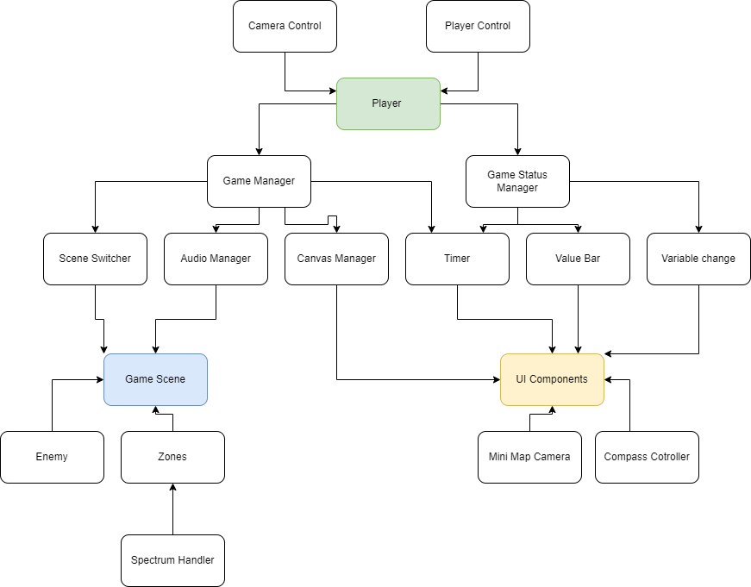
System architecture

Slide 26
Techniques
Finite State Machines
Spectrum Data
Enemy Chasing
Event Driven Development

Slide 27
Techniques - Player Finite State Machine
Idle
WASD pressed
Walk
Keyboard
Released
Space pressed
Back to ground
Jump

Slide 28

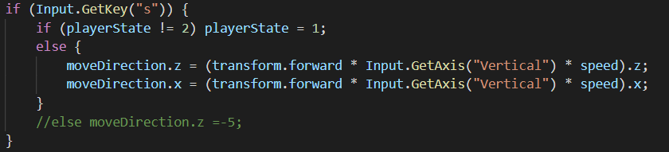
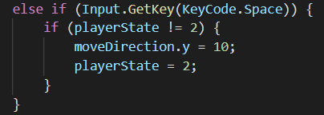
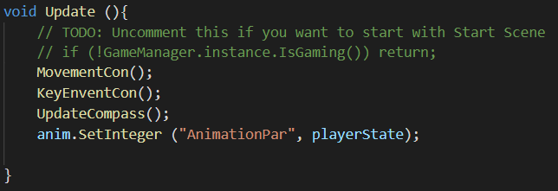

Slide 29
Techniques - NPCs Finite State Machine
player enters chasing range
Idle
Chase
player leaves chasing range

Slide 30
Techniques - Spectrum Data
Unity AudioListener API.

Slide 31
Techniques - Spectrum Data
Audio Source
Get spectrum data from the audio
Spectrum Beat
Spectrum Handle
Spectrum Hit
Spectrum data
Spectrum data
According to the spectrum data, show the visual effect.
According to the spectrum data, switch the zones.

Slide 32
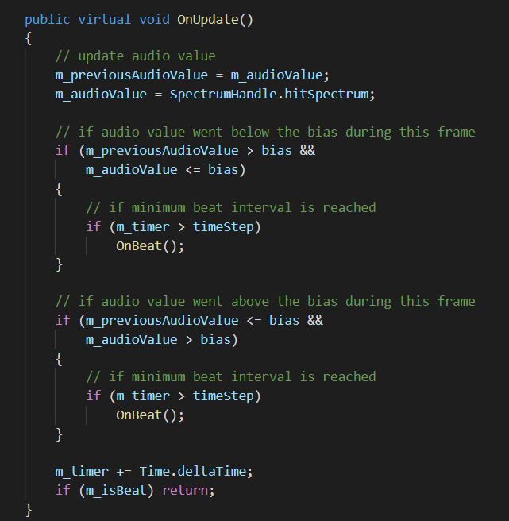
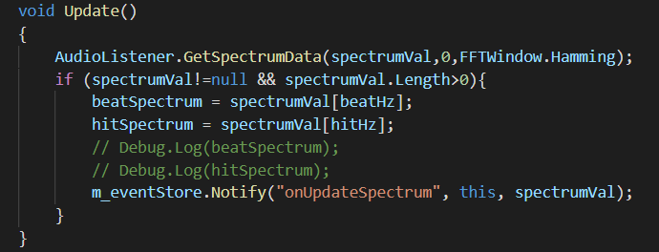

Slide 33
Techniques - Chase
Random scatter NPCs in three levels
The NPCs will chase the player if the player is too close to the NPC
Set perspective for NPCs to fit the reality.
Use the animator to control NPCs’ animations between idle and chasing
Notes:
NPCs are those who will grab the player’s resources, such as facemasks and needles.
If the collision between NPCs and the player occurs, black and red particles will burst out, just like blood and virus.
there are three steps to fulfill this task

Slide 34
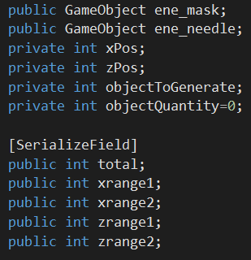
Techniques - Chase
Random scatter NPCs in three levels
Enemy.cs :
scatter two different NPCs to grab the player’s different supplies
facemask
needle
enable to input variables outside the script
which can easily set variables in different levels

Slide 35
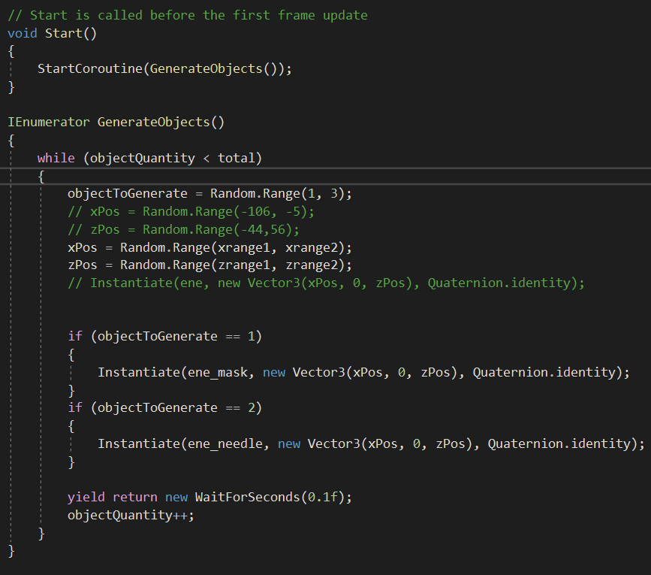
Techniques - Chase
Random scatter NPCs in three levels
Enemy.cs :
Use Random.Range()
set random positions for each NPC in the level

Slide 36
Techniques - Chase
Random scatter NPCs in three levels
Enemy.cs :
randomly choose to scatter two different kinds of NPCs

Slide 37
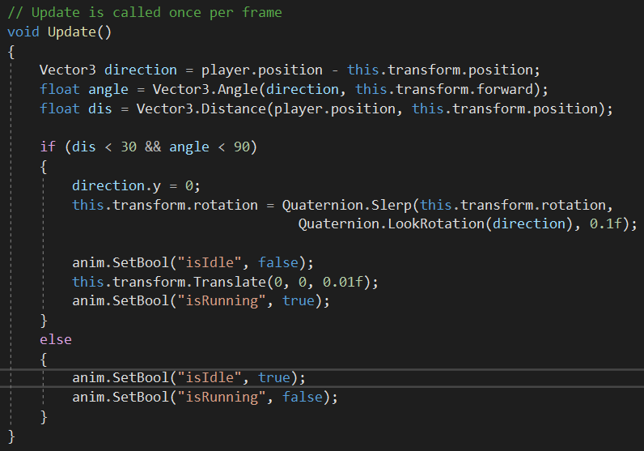
Techniques - Chase
The NPCs will chase the player if the player is too close to the NPC.
Chase.cs :
float dis : compute distance between the player and the NPC
detect the chasing range
if the player is inside the chasing range, the NPC will turn to the player’s direction and chase forward

Slide 38
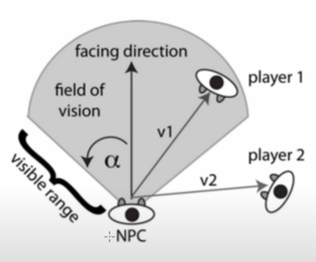
Techniques - Chase
Set perspective for NPCs to fit the reality
Chase.cs :
float angle : compute NPC’s perspective

Slide 39
Techniques - Chase
Use the animator to control NPCs’ animations between idle and chasing
switch the animations of NPCs in Chase.cs

Slide 40
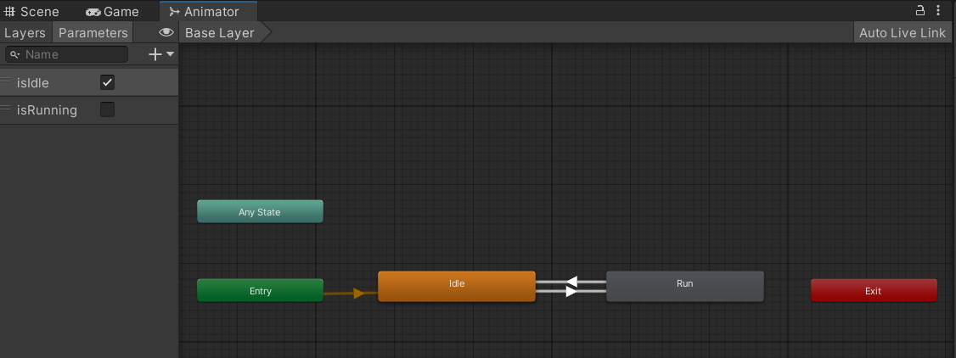
Techniques - Chase
Use the animator to control NPCs’ animations between idle and chasing
define animations in animator

Slide 41
Techniques - Event Driven Development (EDD)
Notify
Register
Class A
Class A’
Event Manager
Topic: EventType 1
Class B
Class B’
Topic: EventType 2
…
Class C
Class C’
…
…

Slide 42
Contributions & Implementation Items
#Total lines: 356
#Total lines:___________
#Total lines: 274
吳岱容
Player control
Player camera
Player animation states
Song edition of each level
Spectrum Control
李諭樹
Scenes connection
Game workflow
UI components and layouts
Event store
Game and audio managers
Connection of the components
呂思函
Three level settings
Enemy animation and chasing
Particle system
Sound effects
Game intro

Slide 43
Milestones & Schedule
李諭樹
呂思函
吳岱容
Nov.
Dec.
Jan.
Procedure Spec Brainstorm
Resource Collection & Draft
Component Construction & Integration
Testing
Procedure spec design
UI design
Scene construction
Integration
Testing
Development environment setup
Scene build up
Game AI
Media collection
Spectrum controller

Slide 44
Conclusion
A game combining rhythm game factors and other elements to make it excited and creative.
Some things can be improved (eg. multiplayer game mode, UX experience).

Slide 45
Acknowledgement & Reference Lists
Acknowledgement
This idea is somehow inspired by the Crypt of the NecroDancer (developed by Brace Yourself Games) and Super Mario 3D Land (developed by Nintendo).
Reference List
Unity Asset Store
Sketchfab
CGTrader
Youtube

Slide 46
Thank you for your listening (๑•̀ㅂ•́)و✧

Slide 47
Technical section
Must implement three techniques
These techniques must be implemented on your own
Show us the source code
Show all techniques
Show demo video clips for each technique

Slide 48
e.g., Finite state machine(s) in the game
Draw a figure
Show source code

Slide 49
e.g., Physics
Draw a figure
Show source code

Slide 50
e.g., Networking
Draw a figure
Show source code

Slide 51
e.g., Particles
Draw a figure
Show source code

Slide 52
Contributions & Implementation items
List all the items that are implemented by each member
List the number of lines of source code implemented by each member
Contribution ratios (Added up to 100%)
Work hours of each member

Slide 53
Contributions & Implementation items
Contribution ratios (Added up to 100%)
Number of lines implemented
Member 1 | Contribution %
Item | Description
Member 2 | Contribution %
Item | Description
Member 3 | Contribution %
Item | Description
#Total lines:___________
#Total lines:___________
#Total lines:___________

Slide 54
Online Demo
Run your program
Run through your game

Slide 55
S
W
O
T
Strengths
Weakness
Opportunities
Threats
Diverse Interaction mode :
Interactions between the player, NPCs, props, and the terrain.
Game mode is monotonous.
Develop diverse game mode and increase exposure rate online.
Several factors will block the development of game
music switches safe and dangerous zone
Particles will burst out if collision happens.
props
NPCs
single-player game
cannot publish online without payment
low exposure rate
examinations are not enough
more time to survey and develop the multi-player game
need funds to publish online (over free capacity)
game is not interesting enough that the examinations are few
time factor is the main threat

Slide 56
Conclusion
Oh, yah, fucking awesome~

